Slide 1
Objectives
Familiarize myself with Pandas, Opencv, PyMuPDF, and other related libraries
Set up above libraries so that I can use them later
Begin looking into biometric data and how it’s being stored, as well as what it can represent

Slide 2
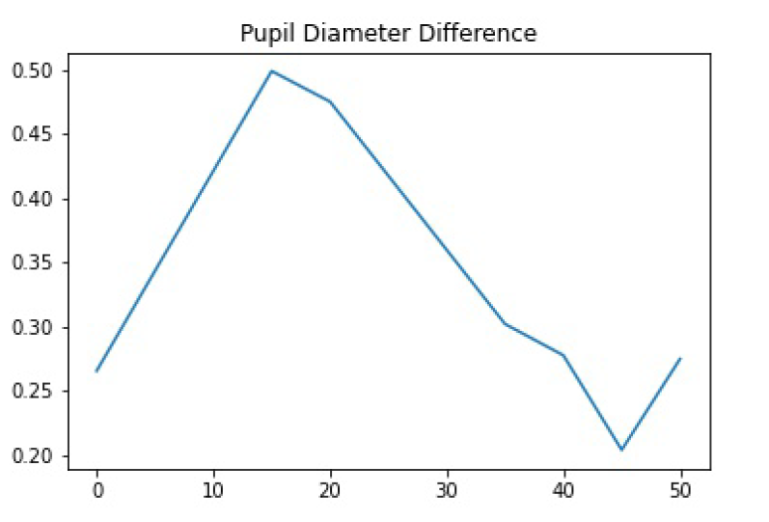
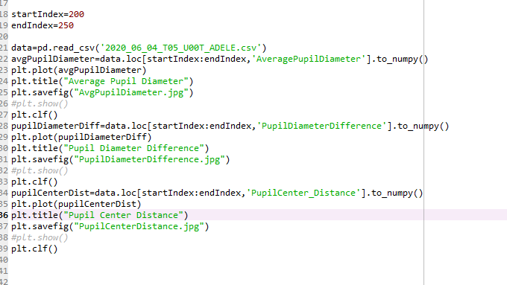
Outcomes

Slide 3
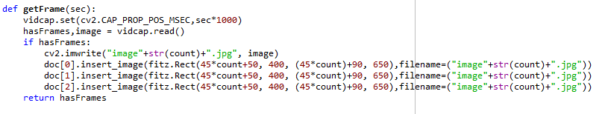
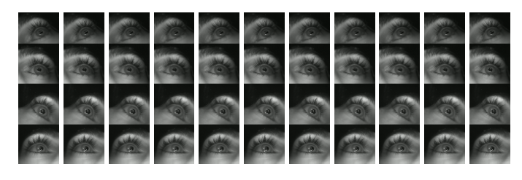
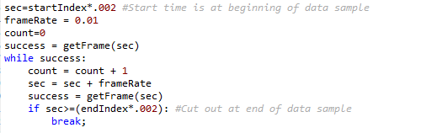
Outcomes

Slide 4
Difficulties
Mostly PyMuPDF being unhelpful in its documentation
Similar problems with OpenCV, but that one required less input to function
Difficulties converting images from one format/module to another
Currently just saving all images and loading them in again, but that’s extremely inefficient with larger sets of data

